Slide 1


Sentiment and Topic Analysis of Donald Trump's 2024 Campaign Speeches
Analyzing Political Communication Strategies
Porimol Chandro
Ho Thi Hoang Nhu
Major in Data Science and Business Analytics
Faculty of Economic Sciences, University of Warsaw

Slide 2

Project Objectives
Analyze sentiment in Trump's speeches.
Track sentiment trends over time.
Categorize speeches into key campaign topics.
Utilize advanced sentiment analysis techniques.

Slide 3

Dataset Collection
Data Sources:
In this sentiment analysis project, we used an election campaign speech delivered by Donald Trump.
Selection Criteria:
Relevance to the 2024 campaign.
Challenges:
Ensuring data completeness and accuracy.

Slide 4

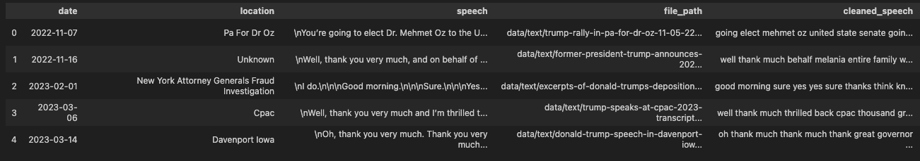
Data Preprocessing
Designed to extract essential metadata and content from file names and speech transcripts., to ensure a structured and efficient approach to organizing and analyzing the dataset.
Text Normalization: Convert all text to lowercase, remove punctuation.
Tokenization: Split text into words or phrases.
Lemmatization: Convert words to their base or root form.
Stop Words Removal: Eliminate common words that do not add significant meaning (e.g., "and”, "of").

Slide 5
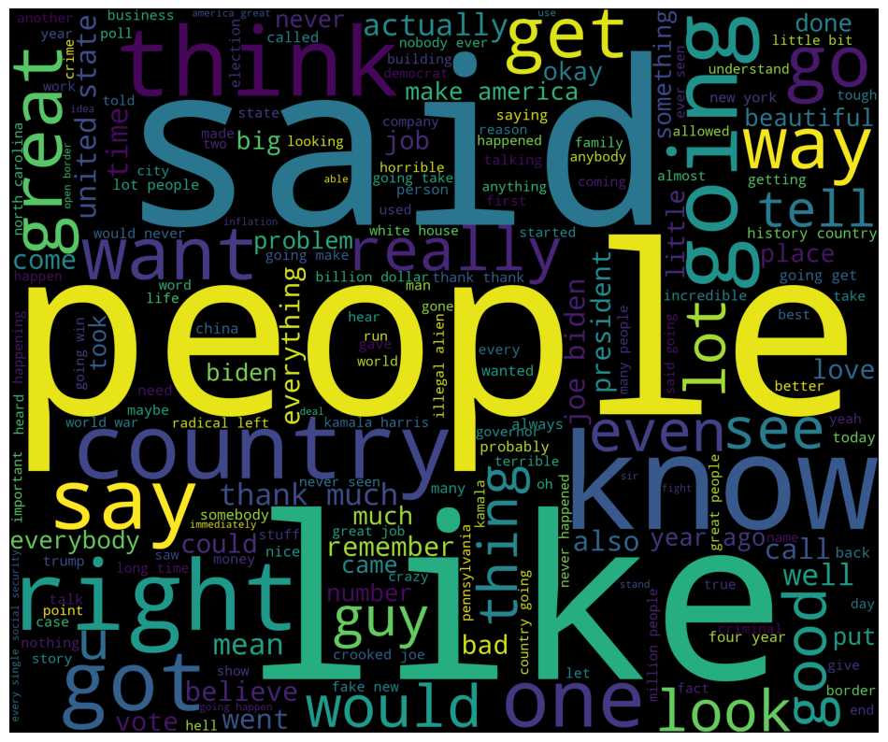
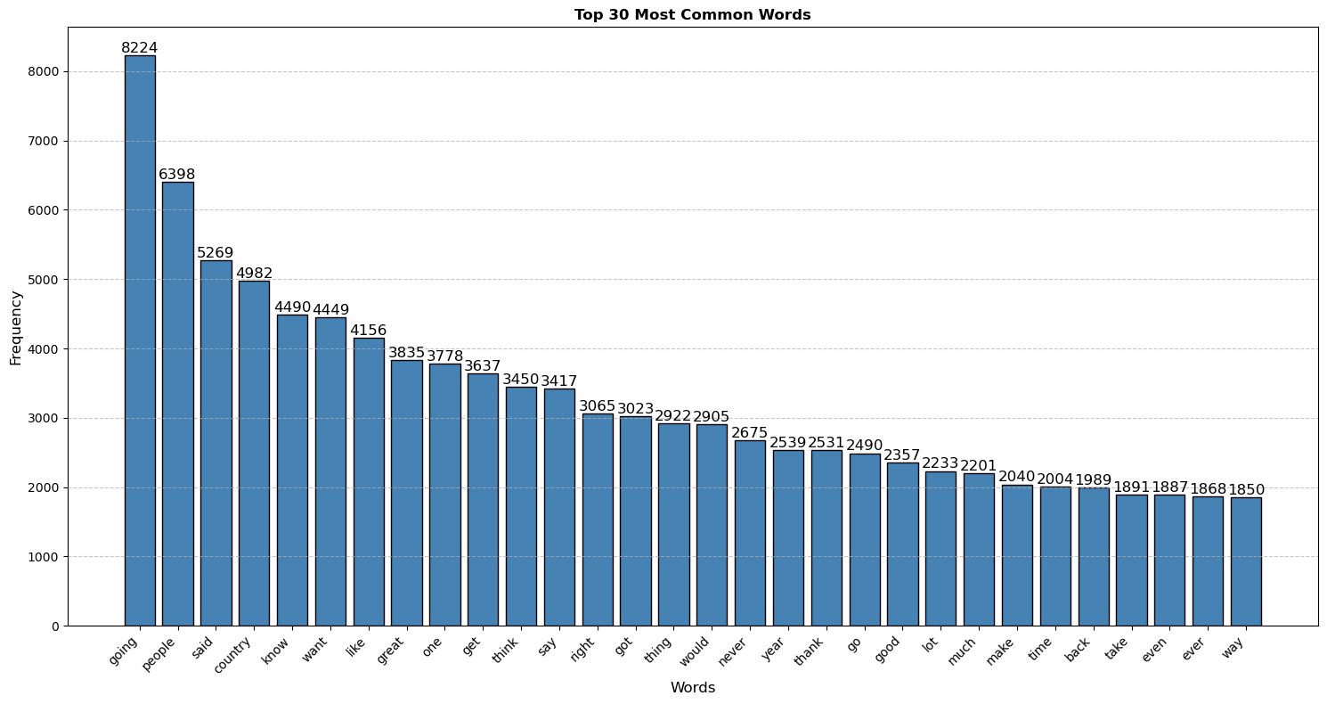
Exploratory Data Analysis (EDA)
"people," "know," "country," and "great" show a focus on connecting with the public and addressing national issues.
Positive terms ("thank," "good") and negative ones ("problem," "bad") reflect a mix of hope and critique.
"going," "people," and "country" stand out prominently in both visuals, reinforcing their significance in the campaign's messaging.

Slide 6
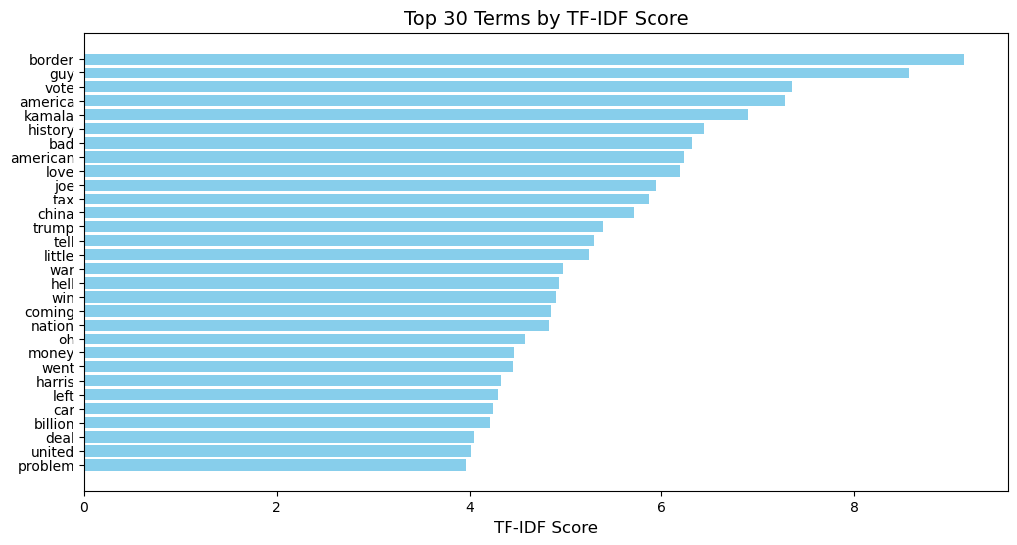
TF-IDF Vectorization
Immigration & Economy: Terms like "border", "tax", and "money" reflect a focus on immigration and economic issues.
Patriotism: Words like "America", "nation", and "united" emphasize national pride.
Opposition: Names like "Joe", "Kamala", and "Harris" signal a focus on political rivals.
Emotional Tone: Terms like "bad", "war", and "hell" suggest charged rhetoric to energize supporters.

Slide 7
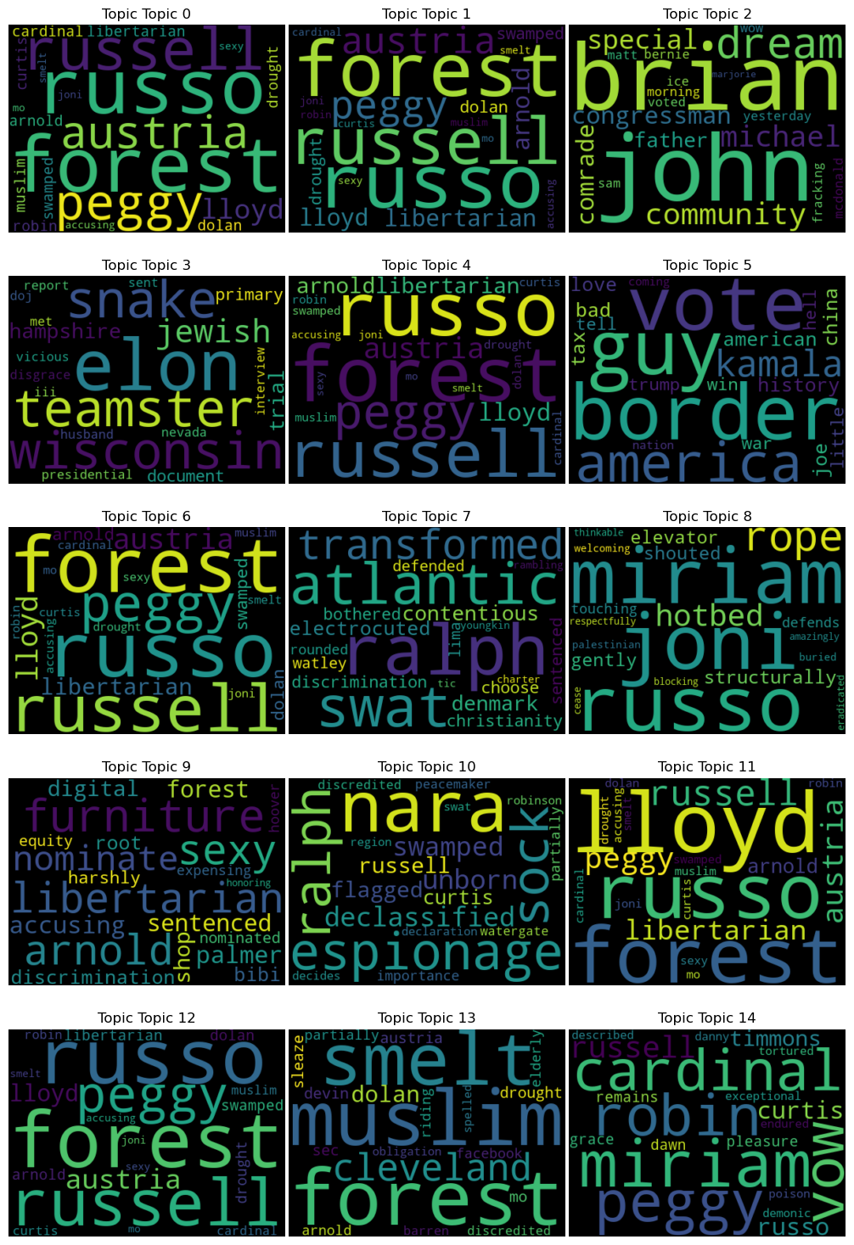
Dirichlet Allocation (LDA)
The Dirichlet Allocation (LDA) model helps analyze latent topics in a text corpus by grouping related keywords into topics.
Each topic represents a thematic analysis of the data and can help us better understand Trump's concerns during his campaign.

Slide 8
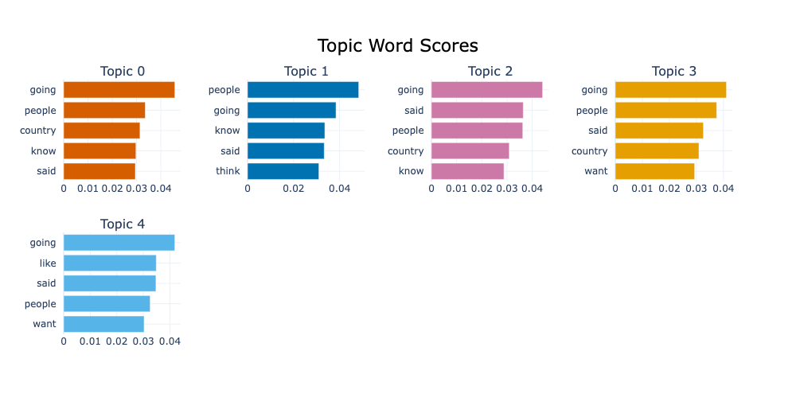
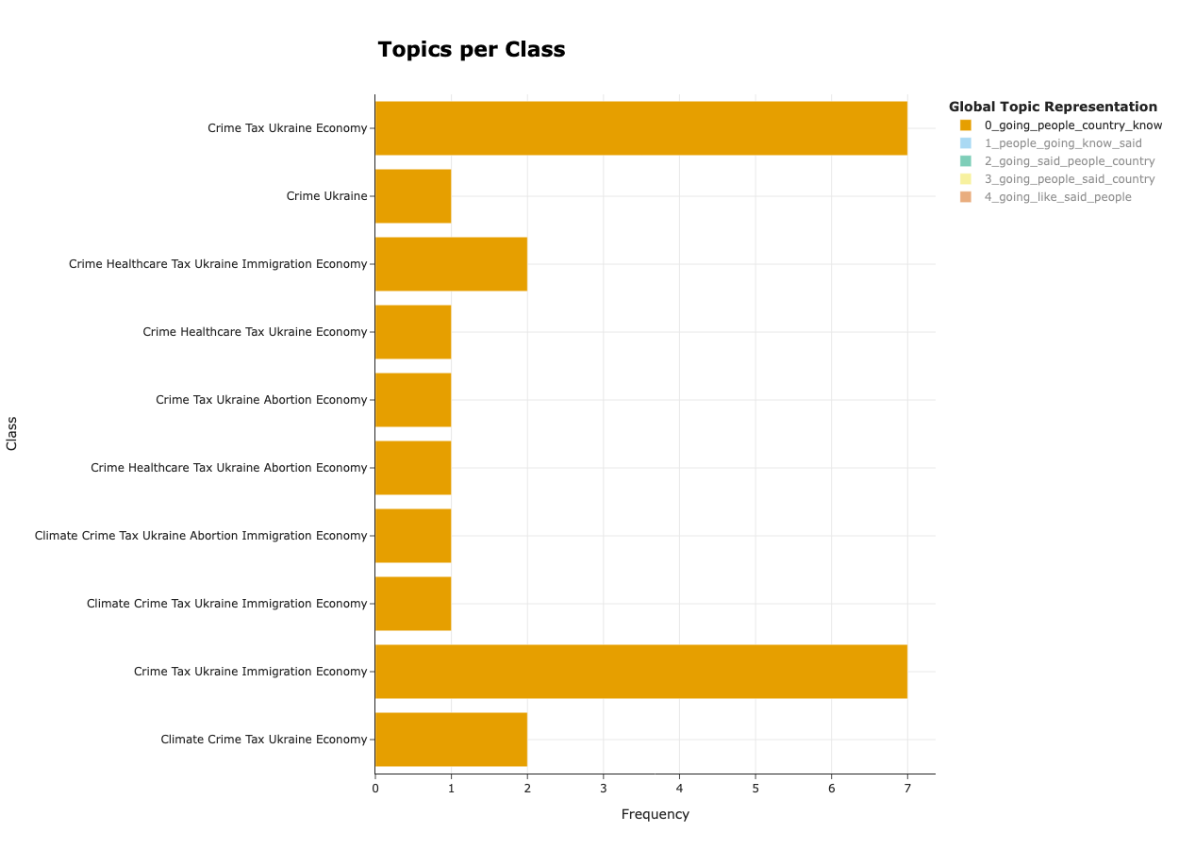
BERT for topic analysis
focus on rime, taxes, Ukraine, and economic challenges as recurring and interconnected themes.

Slide 9
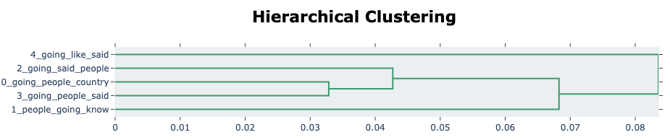
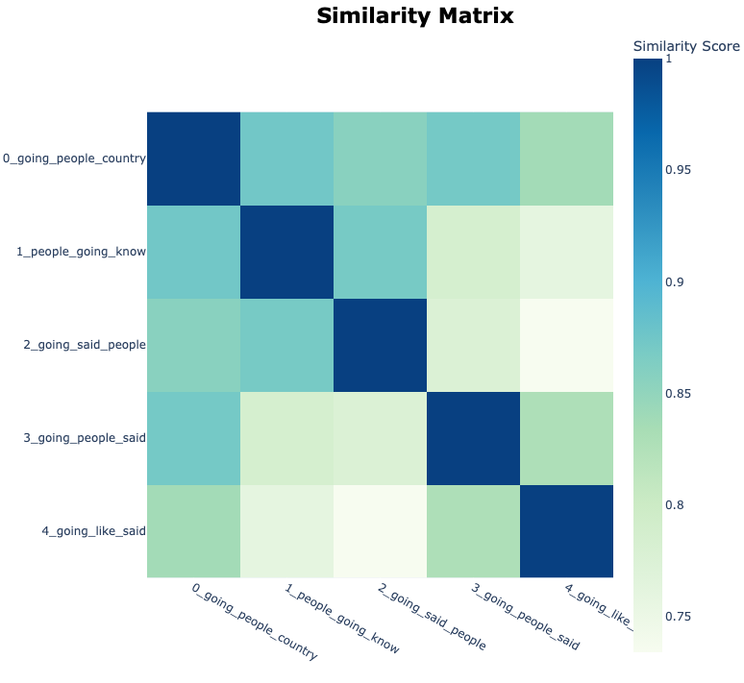
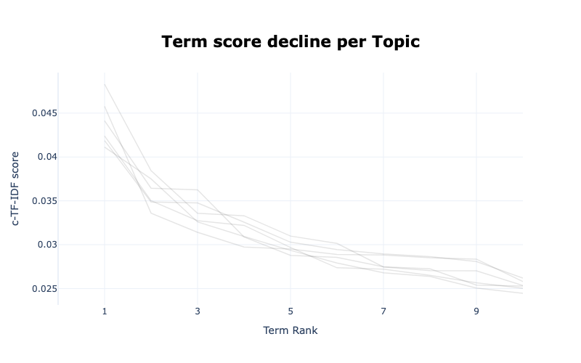
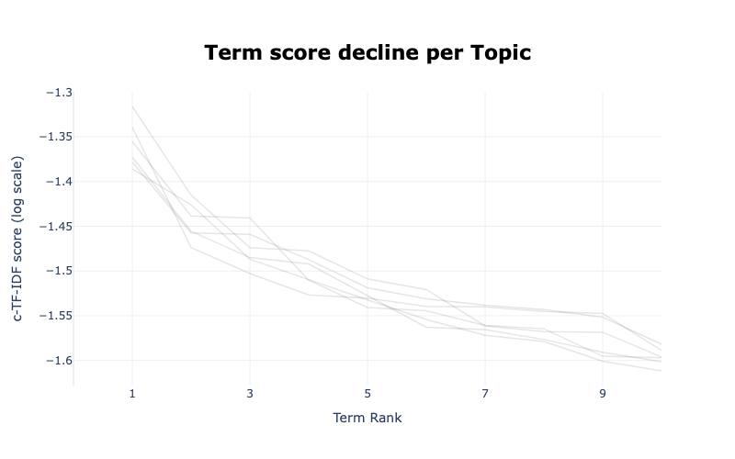
BERT for topic analysis
"0_going_people_country" and "3_going_people_said": discussions about people and broader societal issues
while "4_going_like_said" diverges, indicating distinct content.

Slide 10
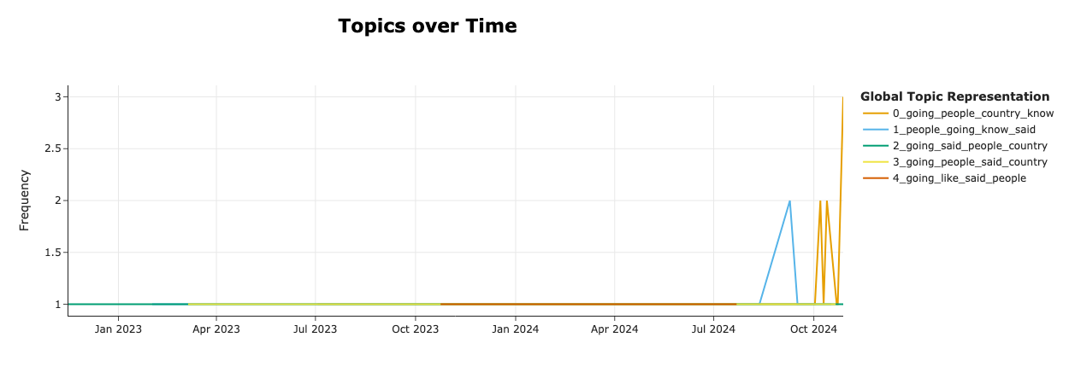
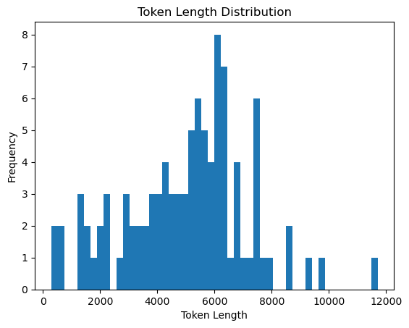
BERT for topic analysis
At the end of October, Donald Trump used words in topic 0 in his meetings to connect with voters, emphasize understanding of the country, and encourage political action.

Slide 11
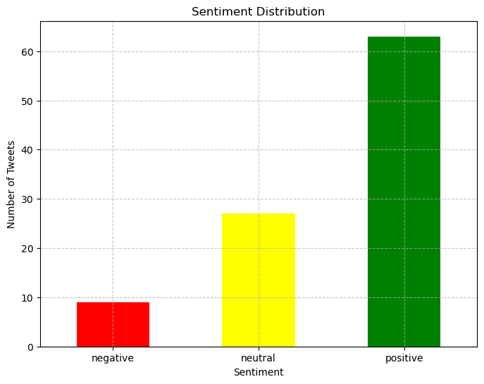
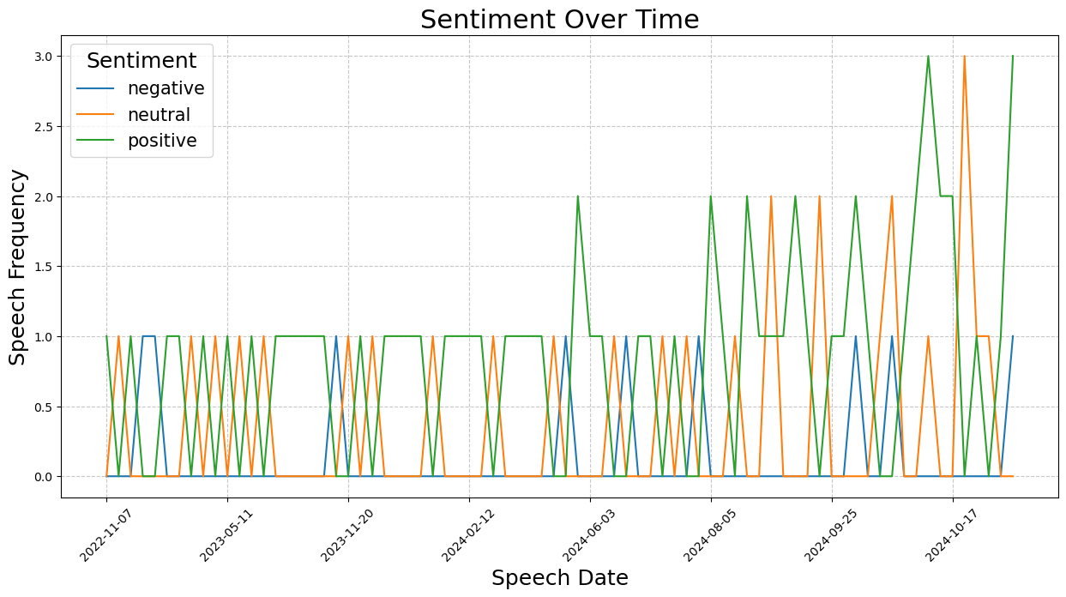
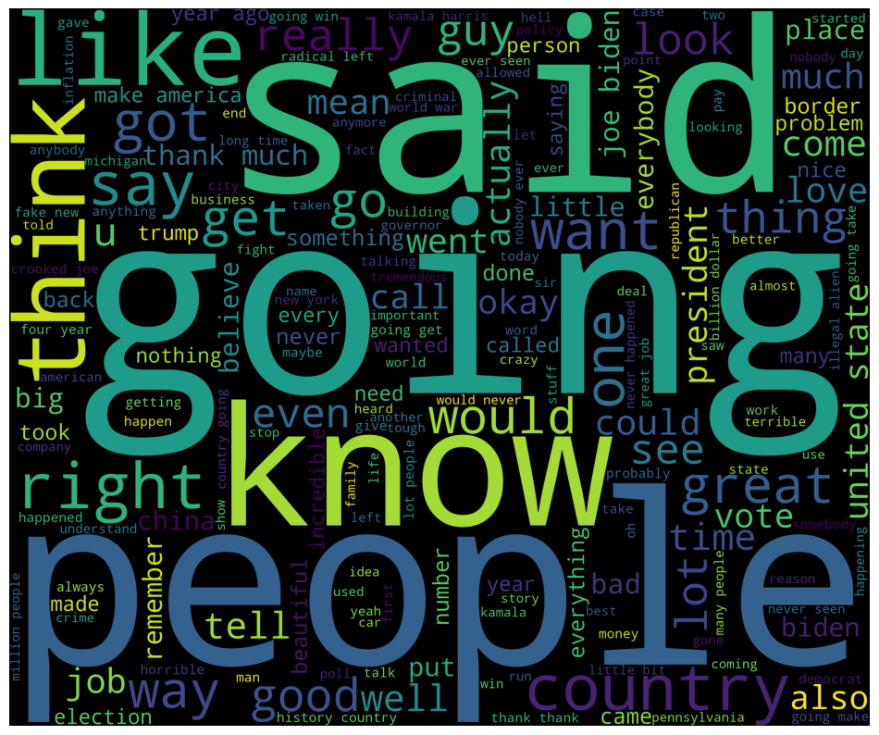
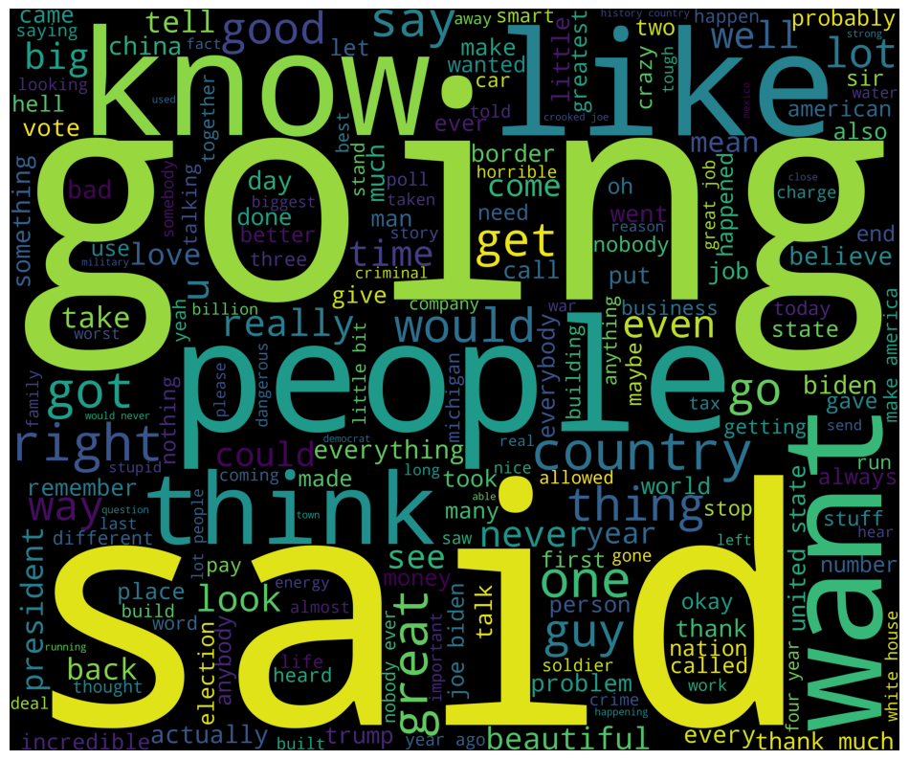
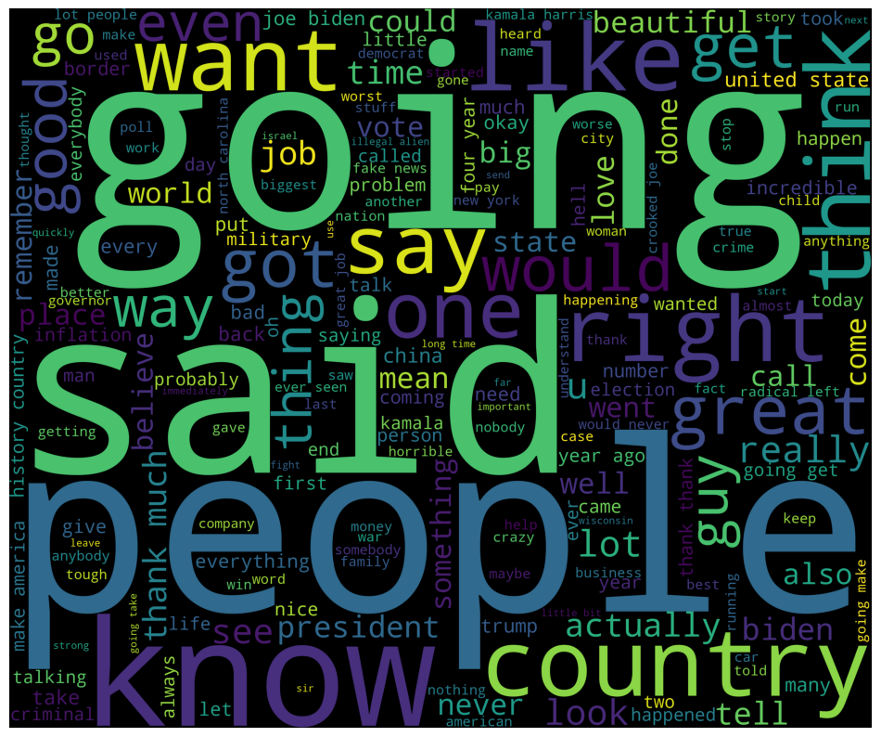
Sentiment Analysis Based on BERT
Positive
Negative
Neutral

Slide 12

Conclusion
Dominant Themes: Focus on immigration, economy, and rivals to address voter concerns.
Emotional Engagement: Use of charged language to connect emotionally and foster urgency.
Temporal Dynamics: Fluctuating sentiment as the campaign nears key electoral periods.
Overall: Sentiment and topic analysis are key to understanding political communication strategies and voter perception. Future campaigns could broaden topics to engage more voters and address diverse interests.

Slide 13
Q&A

Slide 14
Thanks for listening!

